Slide 1
Thesis Meeting
Emilio Benenati
Josyula Viswanath Das

Slide 2
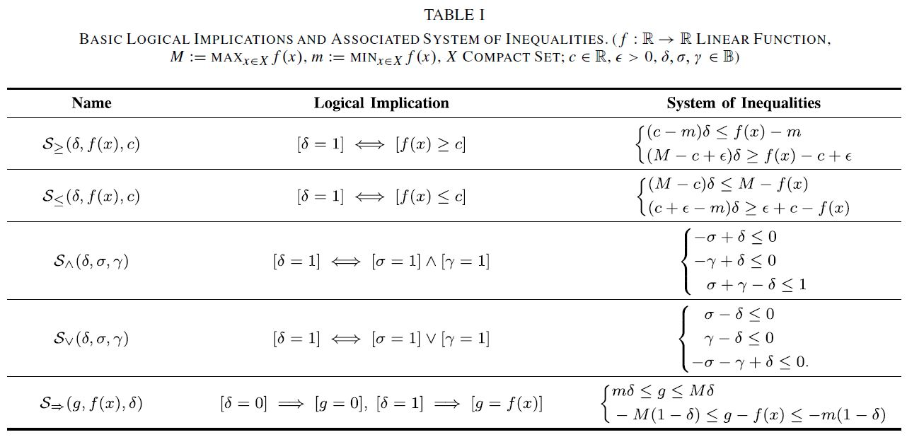

Slide 3
Assumption that the host vehicle knows the lane in which the host vehicle and the obstacle vehicles are along with lateral and longitudinal position and velocity data.
Two formulation of MPC based on if the safe area in the next lane is empty or not.

Slide 4
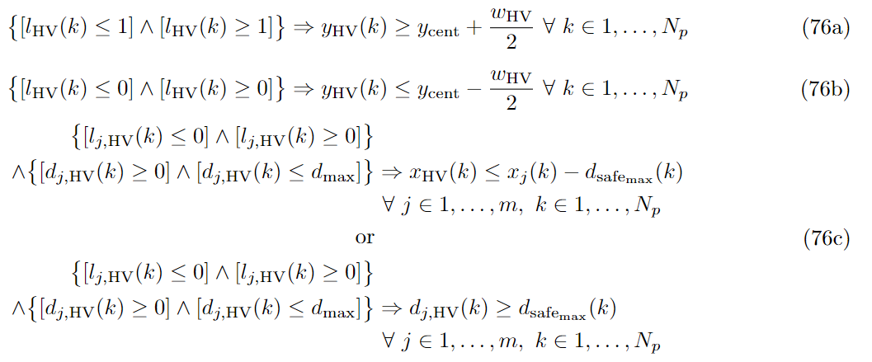
If the safe area is not empty

Slide 5
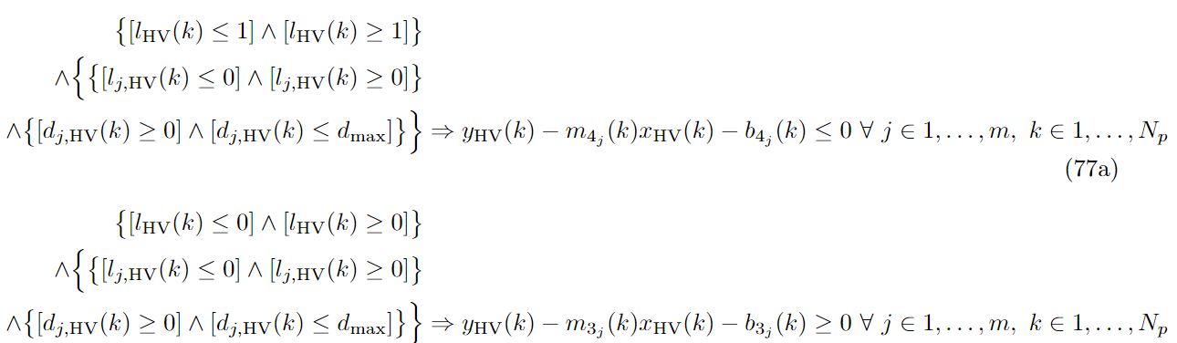
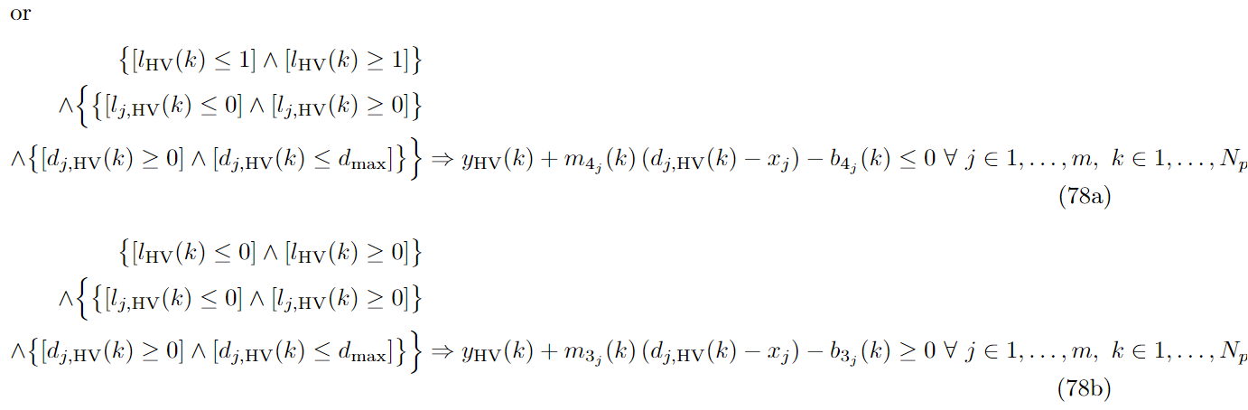
if the safe area is empty then we have a chance of changing lanes

Slide 6
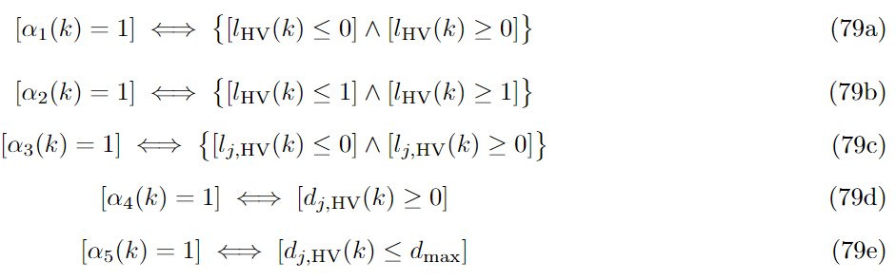
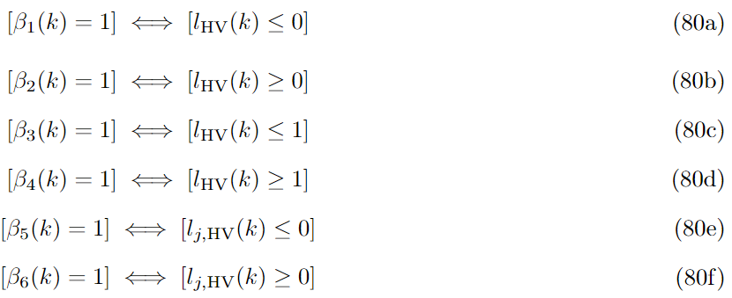
Define logical variables

Slide 7
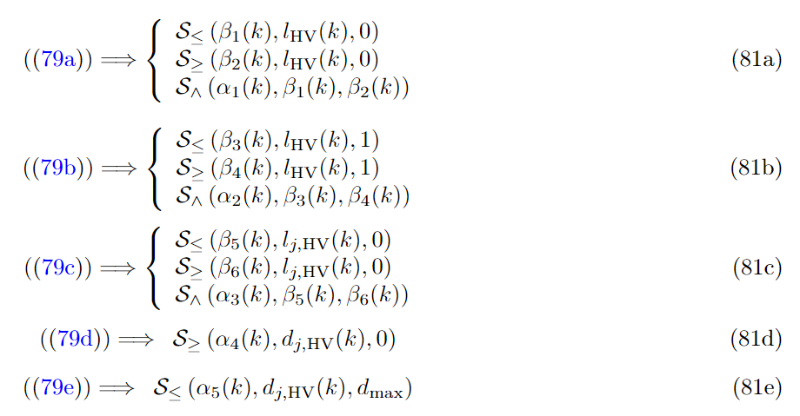
Rewriting the equations in Equation 80 and Table 1, we can rewrite the MLD constraints as sets of linear inequalities given by

Slide 8
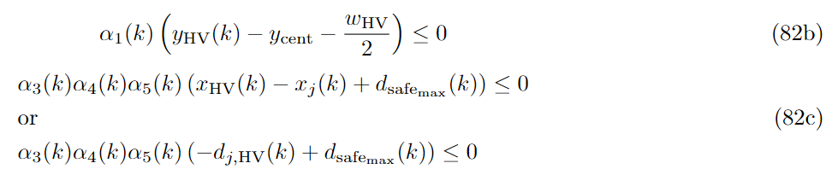
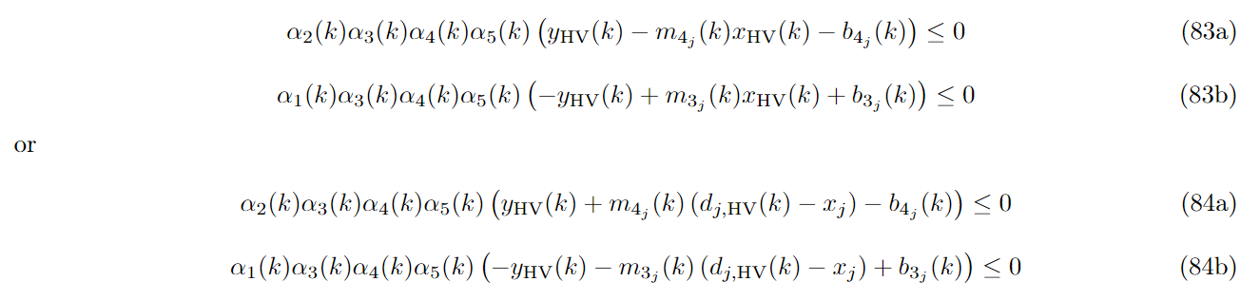
Now we can replace the expressions in Equation 76 using the logical variables defined in Equation 79. We therefore get
Similarly, we can replace the expressions in Equation 77 or Equation 78 using the logical variables defined in Equation 79. We therefore get

Slide 9
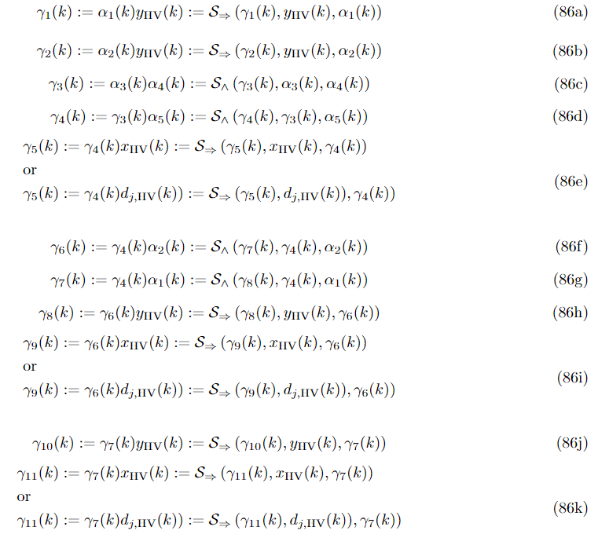
But as we have nonlinearity occurring in the equations we define the new logical variables. The variables and the corresponding linear inequalities are given by

Slide 10
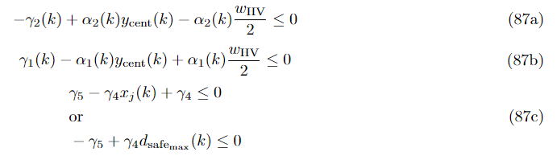
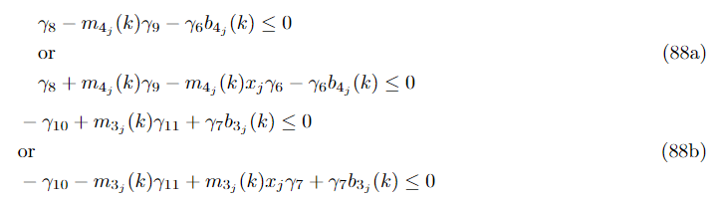
Hence the equations in (82) (83) and (84) can be rewritten as pseudo linear inequalities using these new variables and are given by

Slide 11


Changes made were the addition of a and which represent the maximum safe distance within which no host vehicle should be present and the maximum distance that the host vehicle can perceive respectively.

Slide 12
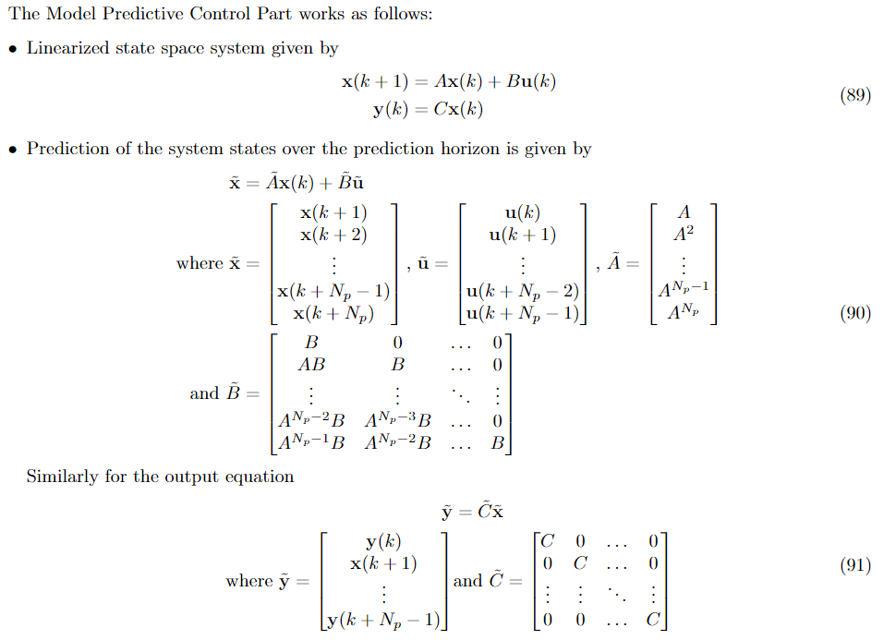
Problems

Slide 13
